Slide 1

LEAKAGE DETECTION USING WATER FLOW SENSOR

Slide 2
Introduction
Water flow sensor is used to detect the leakage
It has a small rotating rotor to induce electricity within the yellow wire as a signal to the NodeMCU.
In this project, we don’t have water pump, we use a blow within that flow to generate the signal to the NodeMCU.

Slide 3
PROJECT OBJECTIVES
To detect and to determine the location of the damage when there is a leak by real time monitoring.
To monitor the flow of water
To alert people or the user of the pipeline when there is a leakage.

Slide 4
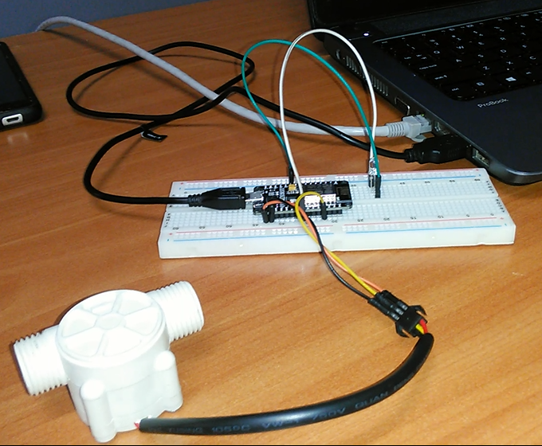
Project diagram

Slide 5
Hardware components
Water flow sensor
NodeMCU
Jumper wires
LED
Bread board
USB cable

Slide 6
Hardware connection
The water flow sensor has three wires. Which are connected in the following way:
Black is connected to the ground of NodeMCU
Yellow is connected to digital pin 2 of the NodeMCU.
Red is connected to VCC of NodeMCU.
The LED is connected to digital pin D5 and to ground of the nodeMCU

Slide 7
Software connection
The software is also as for Arduino uno or another board like Arduino IDE but we have to include the driver for WiFi.
The module ESP8266 is used
In the code we have pubsubclient which has to upload the code to MQTT blocker.

Slide 8
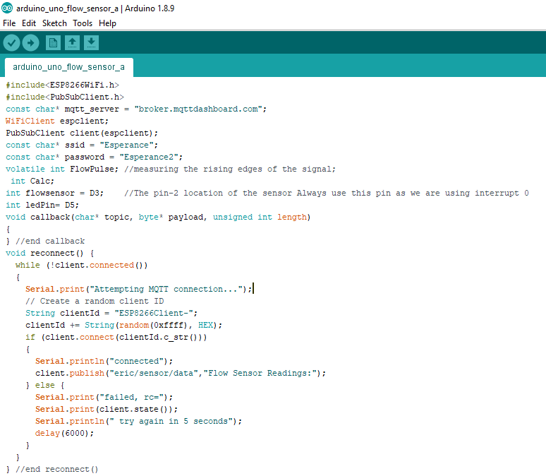
Project codes

Slide 9
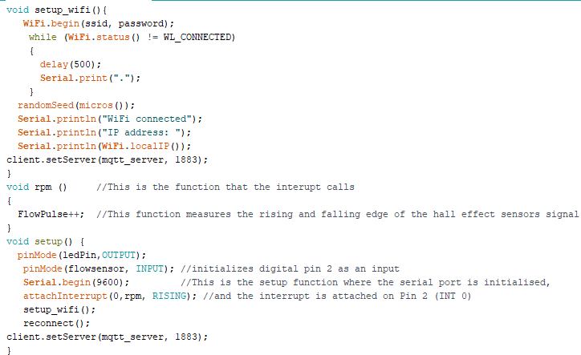
Project Codes Cont’d.

Slide 10
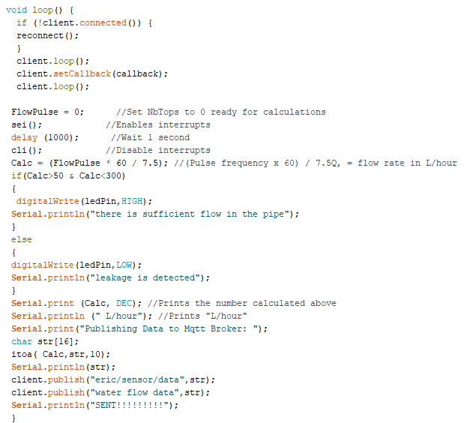
Project Codes Cont’d.

Slide 11
Project result
To calculate data from sensor, the flow sensor will calculate data then will save data in Calc.
The memory Calc will save the data.
The condition is that the leakage will be happen when the calc is between 50 and 300 in order to avoid interference.

Slide 12
Simulation
When you blog in the sensor , the serial monitor shaw various data.
When the shown data is below 50 and above 300, there is no signal means that there is sufficient flow and the LED will be OFF.
When the shown data is between 50 and300, there is signal means that there is a leakage and the LED will be ON.
The code also will be uploaded to the MQTT when you blog.

Slide 13
Conclusion
As The Recommendation To The User, when you have a water pump you have to adjust the value we have used above 3000 because water pump has enough power .

